Slide 1


<Name>
<Date>

Slide 2

Outline
Executive Summary
Introduction
Methodology
Results
Conclusion
Appendix

Slide 3
Executive Summary
In this endeavor we employ Webscraping methodologies with API calls. Data cleaning and data prep strategies. SQL queries for data insights, as well as data visualization tools, and interactive dashboards. We utilize machine learning models such as KNN and SVM and logistic regression models to produce the final model with a accuracy of 0.78

Slide 4
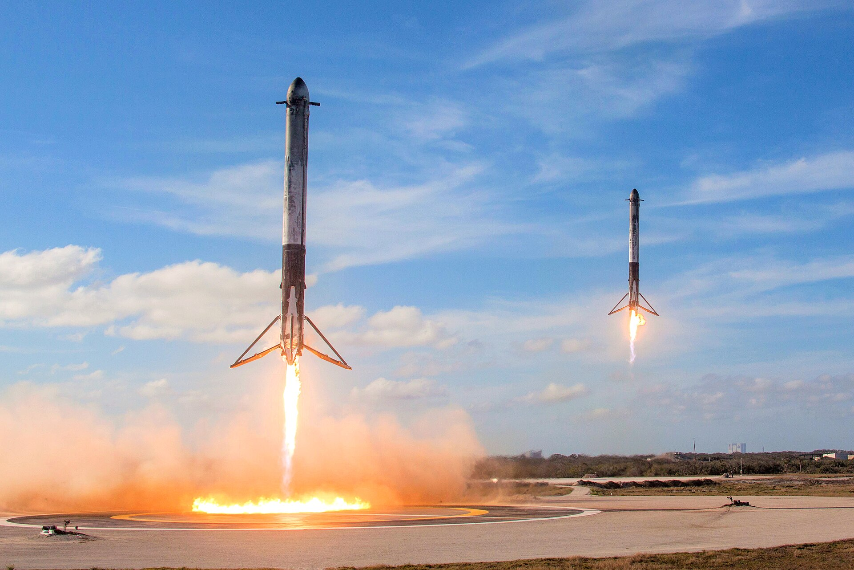
Introduction
As of 16 November 2024, rockets from the Falcon 9 family have been launched 408 times, with 405 full mission successes, three failures(SpaceX 2010)(Wikipedia).
Launching Space Rockets is a multibillion dollar endeavor, that is both crutial to progessing science in the public and private sectors.
Methods to reduce cost and wastes of rocket launches are many such as reusable rockets. However prediction methods of successful launches may be possible in order to reduce chances of failure using know features of successful launches.
We aim to find a model to predict successful launch sites.
SpaceX 2018

Slide 5

Section 1

Slide 6
Methodology
Executive Summary
Data collection methodology:
The data was sourced from the SPACEX RESTfuL API were separated features were combined into one data set. The data was also web scraped from various website such as Wikipedia launch information on spacex heavy carriers
Perform data wrangling
The data was processed and cleaned for specific carrier such as falcon 9 and null values were removed
Perform exploratory data analysis (EDA) using visualization and SQL
Perform interactive visual analytics using Folium and Plotly Dash
Perform predictive analysis using classification models
The model was built using a multiple linear regression model using features engineered from launch site characteristicss
Ebsite such

Slide 7
Data Collection
API (SpaceX API)
JSON to Data fram
Data Cleaning
Data Merging
Data Validation

Slide 8
Data Collection – SpaceX API
Present your data collection with SpaceX REST calls using key phrases and flowcharts
Add the GitHub URL of the completed SpaceX API calls notebook (must include completed code cell and outcome cell), as an external reference and peer-review purpose
ApI call
Data VerificationPlace your flowchart of SpaceX API calls here
JSON Data Retrieved
JSON to DF
SAve to CSV

Slide 9
Data Collection - Scraping
Present your web scraping process using key phrases and flowcharts
Add the GitHub URL of the completed web scraping notebook, as an external reference and peer-review purpose
Place your flowchart of web scraping here

Slide 10
Data Wrangling
Describe how data were processed
You need to present your data wrangling process using key phrases and flowcharts
Add the GitHub URL of your completed data wrangling related notebooks, as an external reference and peer-review purpose

Slide 11
EDA with Data Visualization
Summarize what charts were plotted and why you used those charts
Add the GitHub URL of your completed EDA with data visualization notebook, as an external reference and peer-review purpose

Slide 12
EDA with SQL
Using bullet point format, summarize the SQL queries you performed
Add the GitHub URL of your completed EDA with SQL notebook, as an external reference and peer-review purpose

Slide 13
Build an Interactive Map with Folium
Summarize what map objects such as markers, circles, lines, etc. you created and added to a folium map
Explain why you added those objects
Add the GitHub URL of your completed interactive map with Folium map, as an external reference and peer-review purpose

Slide 14
Build a Dashboard with Plotly Dash
Summarize what plots/graphs and interactions you have added to a dashboard
Explain why you added those plots and interactions
Add the GitHub URL of your completed Plotly Dash lab, as an external reference and peer-review purpose

Slide 15
Predictive Analysis (Classification)
Summarize how you built, evaluated, improved, and found the best performing classification model
You need present your model development process using key phrases and flowchart
Add the GitHub URL of your completed predictive analysis lab, as an external reference and peer-review purpose

Slide 16
Results
Exploratory data analysis results
Interactive analytics demo in screenshots
Predictive analysis results

Slide 17

Section 2

Slide 18
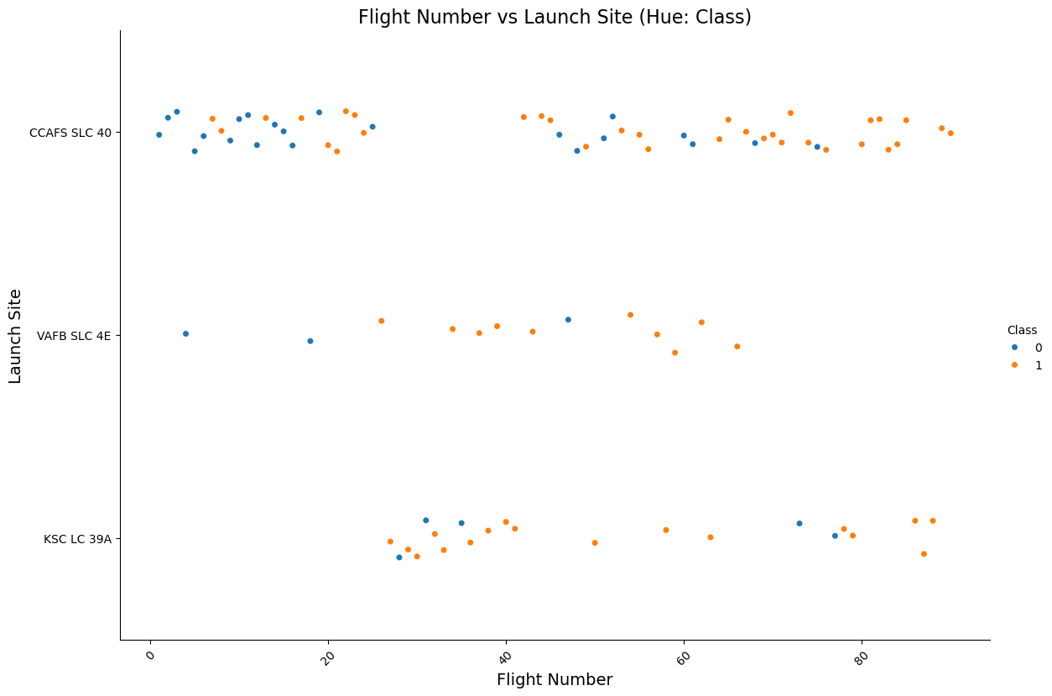
Flight Number vs. Launch Site
Show a scatter plot of Flight Number vs. Launch Site
Show the screenshot of the scatter plot with explanations

Slide 19
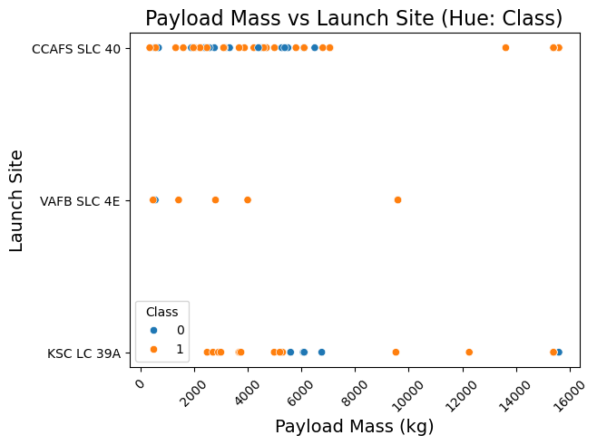
Payload vs. Launch Site
Show a scatter plot of Payload vs. Launch Site
Show the screenshot of the scatter plot with explanations

Slide 20
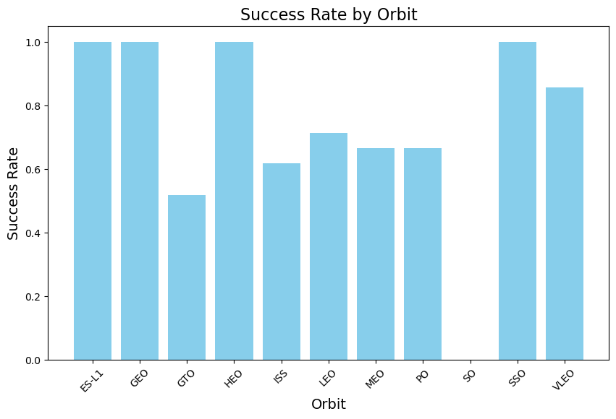
Success Rate vs. Orbit Type
Show a bar chart for the success rate of each orbit type
Show the screenshot of the scatter plot with explanations

Slide 21
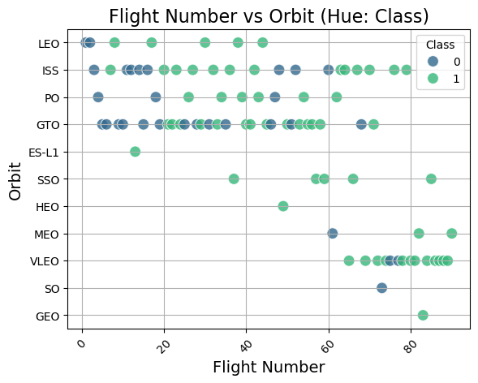
Flight Number vs. Orbit Type
Show a scatter point of Flight number vs. Orbit type
Show the screenshot of the scatter plot with explanations

Slide 22
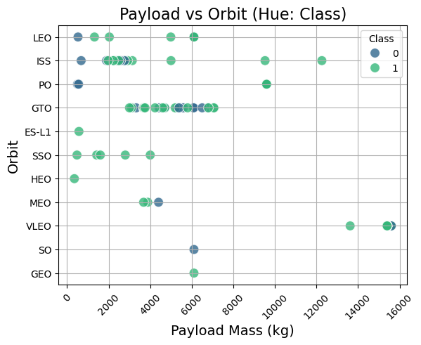
Payload vs. Orbit Type
Show a scatter point of payload vs. orbit type
Show the screenshot of the scatter plot with explanations

Slide 23
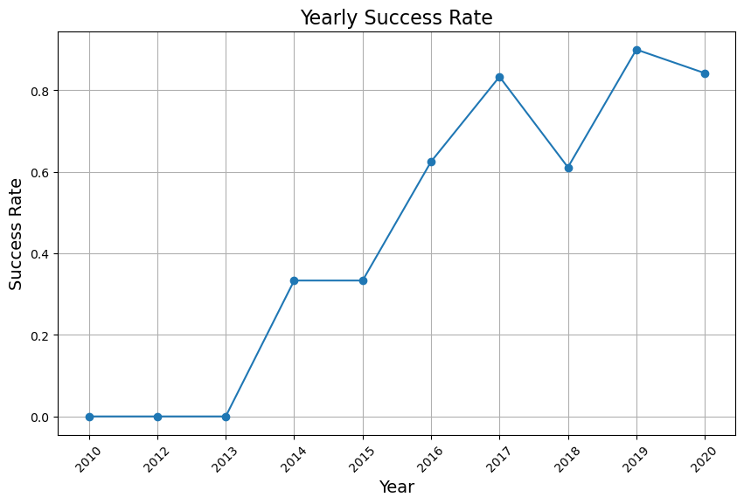
Launch Success Yearly Trend
Show a line chart of yearly average success rate
Show the screenshot of the scatter plot with explanations

Slide 24
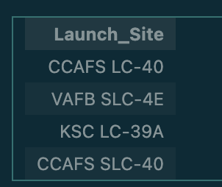
All Launch Site Names
Find the names of the unique launch sites
Present your query result with a short explanation here
%sql SELECT DISTINCT "Launch_Site" FROM SPACEXTABLE;

Slide 25
Launch Site Names Begin with 'CCA'
Find 5 records where launch sites begin with `CCA`
Present your query result with a short explanation here
%sql SELECT * FROM SPACEXTABLE WHERE "Launch_Site" LIKE 'CCA%' LIMIT 5;
Date | Time (UTC) | Booster_Version | Launch_Site | Payload | PAYLOAD_MASS__KG_ | Orbit | Customer | Mission_Outcome | Landing_Outcome
2010-06-04 | 18:45:00 | F9 v1.0 B0003 | CCAFS LC-40 | Dragon Spacecraft Qualification Unit | 0 | LEO | SpaceX | Success | Failure (parachute)
2010-12-08 | 15:43:00 | F9 v1.0 B0004 | CCAFS LC-40 | Dragon demo flight C1, two CubeSats, barrel of Brouere cheese | 0 | LEO (ISS) | NASA (COTS) NRO | Success | Failure (parachute)
2012-05-22 | 7:44:00 | F9 v1.0 B0005 | CCAFS LC-40 | Dragon demo flight C2 | 525 | LEO (ISS) | NASA (COTS) | Success | No attempt
2012-10-08 | 0:35:00 | F9 v1.0 B0006 | CCAFS LC-40 | SpaceX CRS-1 | 500 | LEO (ISS) | NASA (CRS) | Success | No attempt
2013-03-01 | 15:10:00 | F9 v1.0 B0007 | CCAFS LC-40 | SpaceX CRS-2 | 677 | LEO (ISS) | NASA (CRS) | Success | No attempt

Slide 26
Total Payload Mass
Calculate the total payload carried by boosters from NASA
%sql SELECT SUM("PAYLOAD_MASS_KG_") AS TotalPayload FROM SPACEXTABLE WHERE "Customer" LIKE '%NASA%';
Present your query result with a short explanation here

Slide 27
Average Payload Mass by F9 v1.1
Calculate the average payload mass carried by booster version F9 v1.1
%sql SELECT AVG("PAYLOAD_MASS_KG_") AS AveragePayload FROM SPACEXTABLE WHERE "Booster_Version" = 'F9 v1.1';
Present your query result with a short explanation here

Slide 28
First Successful Ground Landing Date
Find the dates of the first successful landing outcome on ground pad
Present your query result with a short explanation here
%sql SELECT "Date" FROM SPACEXTABLE WHERE "Landing_Outcome" = 'Success (ground pad)' ORDER BY "Date" ASC LIMIT 1;
Date
2015-12-22

Slide 29
Successful Drone Ship Landing with Payload between 4000 and 6000
List the names of boosters which have successfully landed on drone ship and had payload mass greater than 4000 but less than 6000
%sql SELECT "Booster_Version" FROM SPACEXTABLE WHERE "Landing_Outcome" = 'Success (drone ship)' AND "PayloadMass" > 4000 AND "PayloadMass" < 6000;
Present your query result with a short explanation here

Slide 30
Total Number of Successful and Failure Mission Outcomes
Calculate the total number of successful and failure mission outcomes
SELECT * SUM("Class") AS Total_Success, COUNT(*) - SUM("Class") AS Total_Failure
FROM SPACEXTABLE;
Present your query result with a short explanation here

Slide 31
Boosters Carried Maximum Payload
List the names of the booster which have carried the maximum payload mass
%sql SELECT DISTINCT "Booster_Version" FROM SPACEXTABLE WHERE "PayloadMass" = (SELECT MAX("PayloadMass") FROM SPACEXTABLE) LIMIT 20;
Present your query result with a short explanation h
there were several more but we have truncated the list for clarity
booster_Version
F9 v1.0 B0003
F9 v1.0 B0004
F9 v1.0 B0005
F9 v1.0 B0006
F9 v1.0 B0007
F9 v1.1 B1003
F9 v1.1
F9 v1.1 B1011
F9 v1.1 B1010
F9 v1.1 B1012
F9 v1.1 B1013
F9 v1.1 B1014
F9 v1.1 B1015
F9 v1.1 B1016
F9 v1.1 B1018
F9 FT B1019
F9 v1.1 B1017
F9 FT B1020
F9 FT B1021.1
F9 FT B1022

Slide 32
2015 Launch Records
List the failed landing_outcomes in drone ship, their booster versions, and launch site names for in year 2015
%sql SELECT "Landing_Outcome", "Booster_Version", "LaunchSite" FROM SPACEXTABLE WHERE "Landing_Outcome" = 'Failure (drone ship)' AND strftime('%Y', "Date") = '2015';
Landing_Outcome Booster_Version "LaunchSite"
Failure (drone ship) F9 v1.1 B1012 LaunchSite
Failure (drone ship) F9 v1.1 B1015

Slide 33
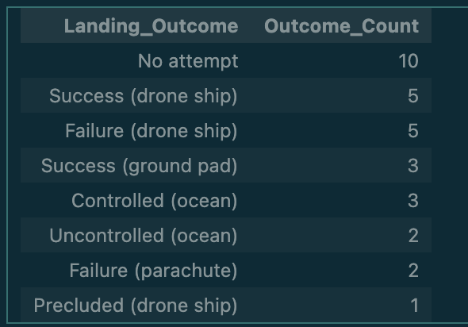
Rank Landing Outcomes Between 2010-06-04 and 2017-03-20
Rank the count of landing outcomes (such as Failure (drone ship) or Success (ground pad)) between the date 2010-06-04 and 2017-03-20, in descending order
%sql SELECT "Landing_Outcome", COUNT(*) AS Outcome_Count FROM SPACEXTABLE WHERE "Date" BETWEEN '2010-06-04' AND '2017-03-20' GROUP BY "Landing_Outcome" ORDER BY Outcome_Count DESC;
Present your query result with a short explanation here

Slide 34

Section 3

Slide 35
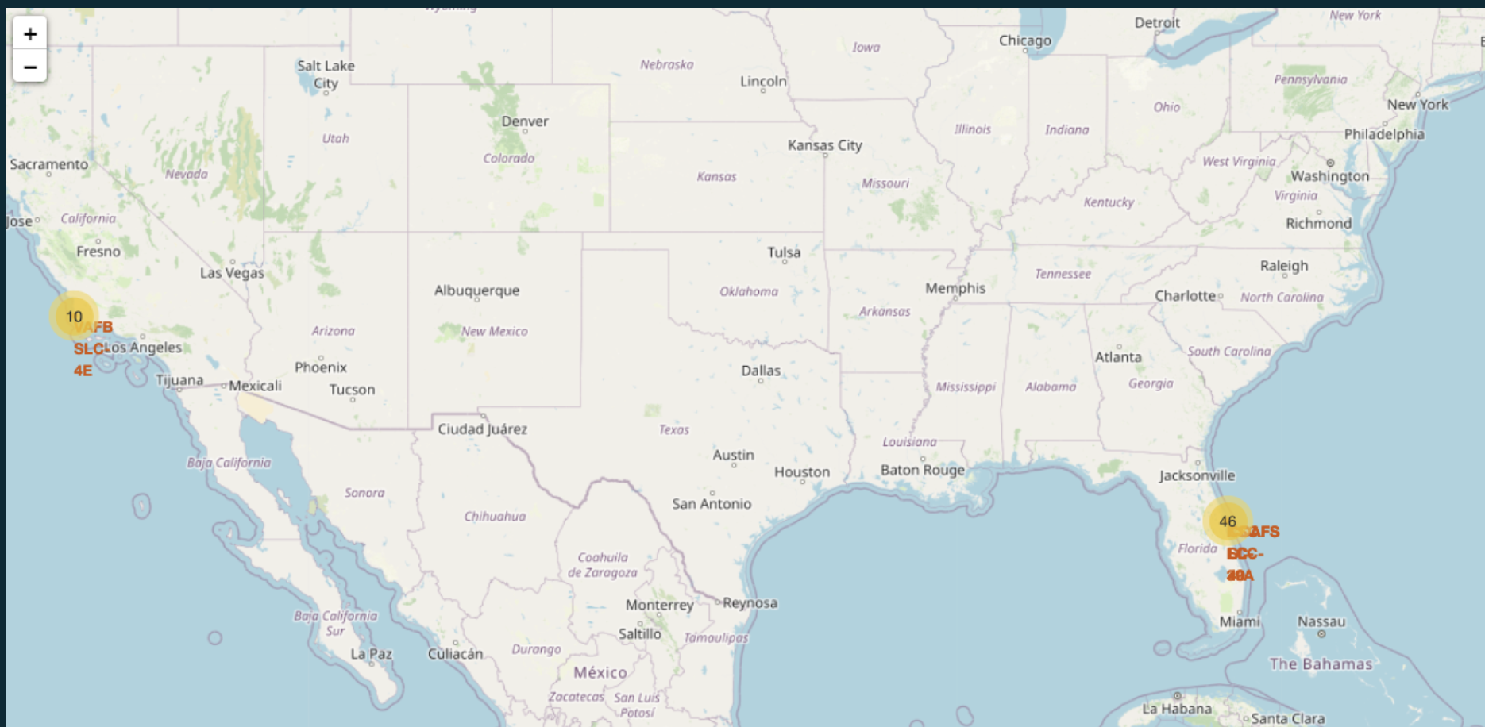
Launch Site Analysis
Explore the generated folium map and make a proper screenshot to include all launch sites’ location markers on a global map
Explain the important elements and findings on the screenshot

Slide 36
Launch Outcomes per Launch Site
Explore the folium map and make a proper screenshot to show the color-labeled launch outcomes on the map
Explain the important elements and findings on the screenshot

Slide 37
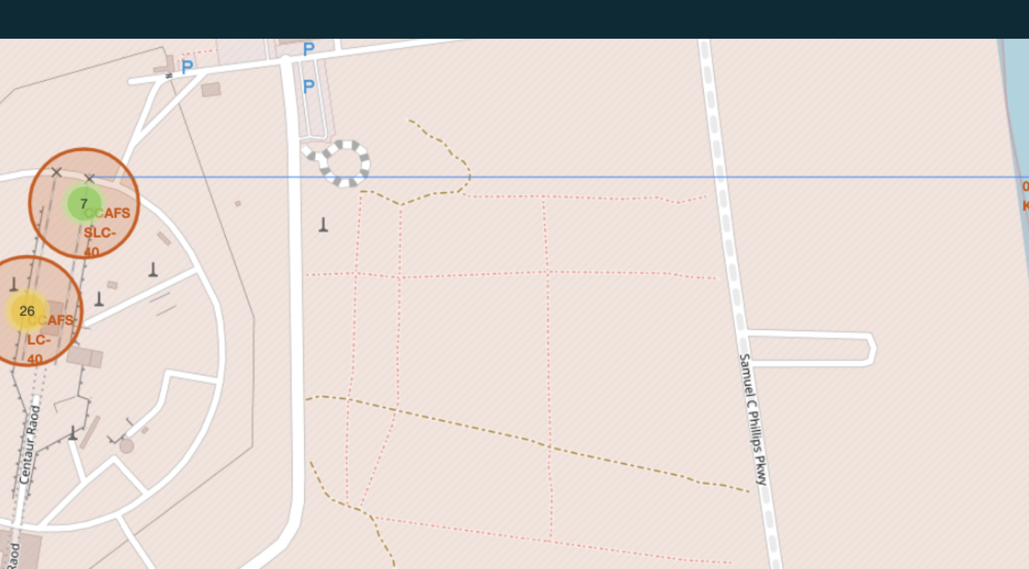
Proximities Calculations to launch Site
Launch site displayed as proximal to landmarks such as railways and cities as a factor for launch site success

Slide 38

Section 4

Slide 39
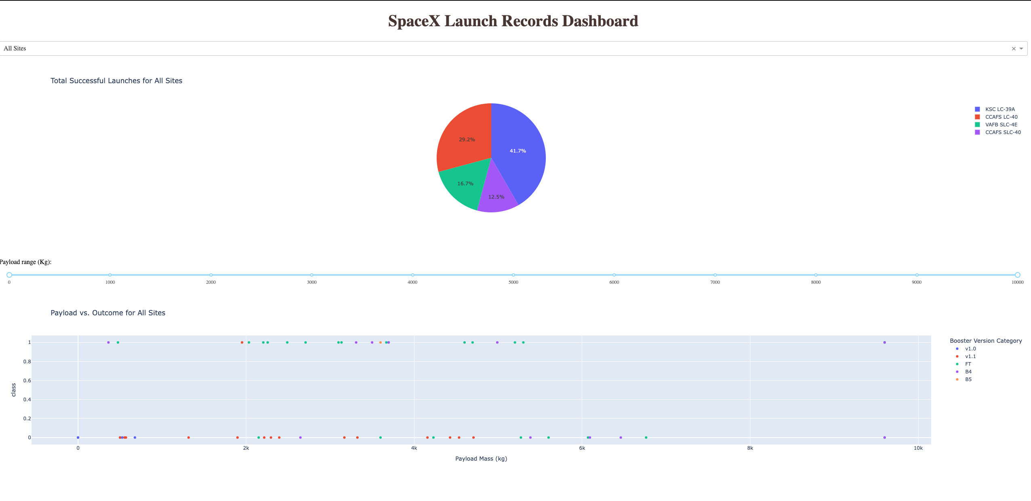
Launch Success Counts per Site

Slide 40
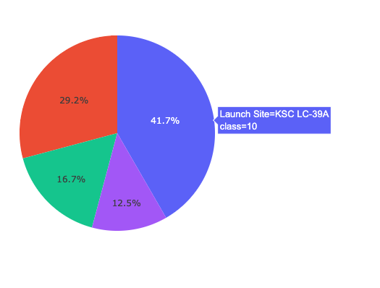
Highest Launch site Ratio
KSC LC-389A Class 10 with a record of 41.7% launches that were successful in this site

Slide 41
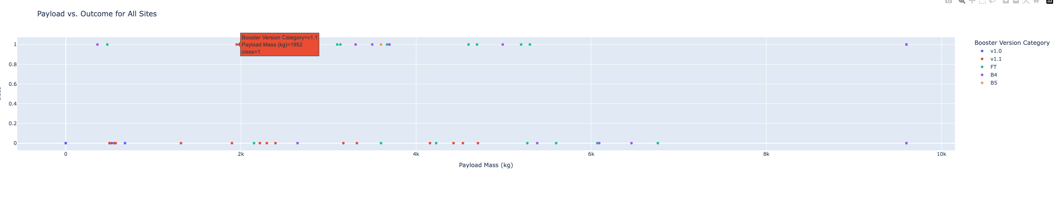
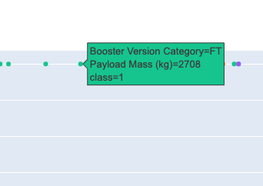
Payload Vs. Launch Outcomes
This is a Dashboard Representation of the Payload vs launch outcomes

Slide 42

Section 5

Slide 43
Classification Accuracy
Visualize the built model accuracy for all built classification models, in a bar chart
Find which model has the highest classification accuracy

Slide 44
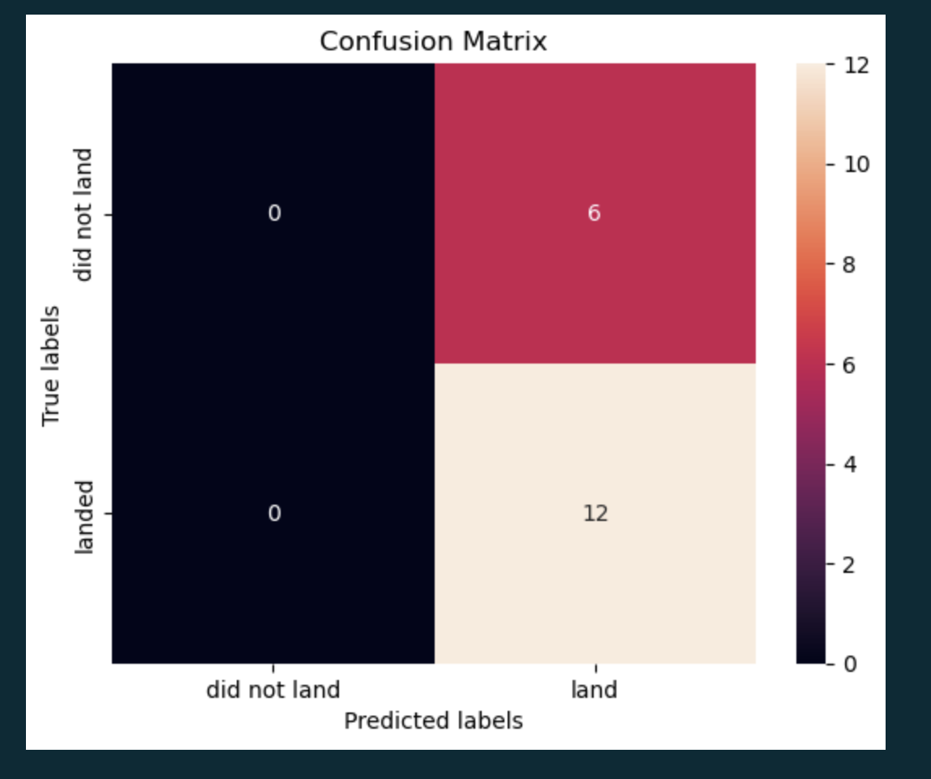
Confusion Matrix
Show the There is a high miss rate in the confusion matrix when predicted true labels of that that did not land

Slide 45
Conclusions
Point 1
Point 2
Point 3
Point 4
…

Slide 46
Appendix
Include any relevant assets like Python code snippets, SQL queries, charts, Notebook outputs, or data sets that you may have created during this project

Slide 47


